Slide 1
CRIME RATE ANALYSIS USING BIG DATA ANALYTICS
BY-
T.K.AISHWARYA
1602-16-737-001

Slide 2
ABSTRACT
Though average crime rates in the India have been in the decline for the last few years , it is still useful to many groups, such as law enforcement, city officials, home buyers, etc., to be able to predict where crime will occur. We develop a model to predict future crime incidence at a future time given a geographical location, leveraging historical crime data from the cities of Hyderabad,Delhi etc.

Slide 3
USE CASES
Using this model, the police force can use the reports as in where the pattern or the type of crime is still at large and is still continuing.
After learning of this they can take necessary steps to stop or prevent the crime from happening.
People can be made aware the nature of crime at the locations to warn them.

Slide 4
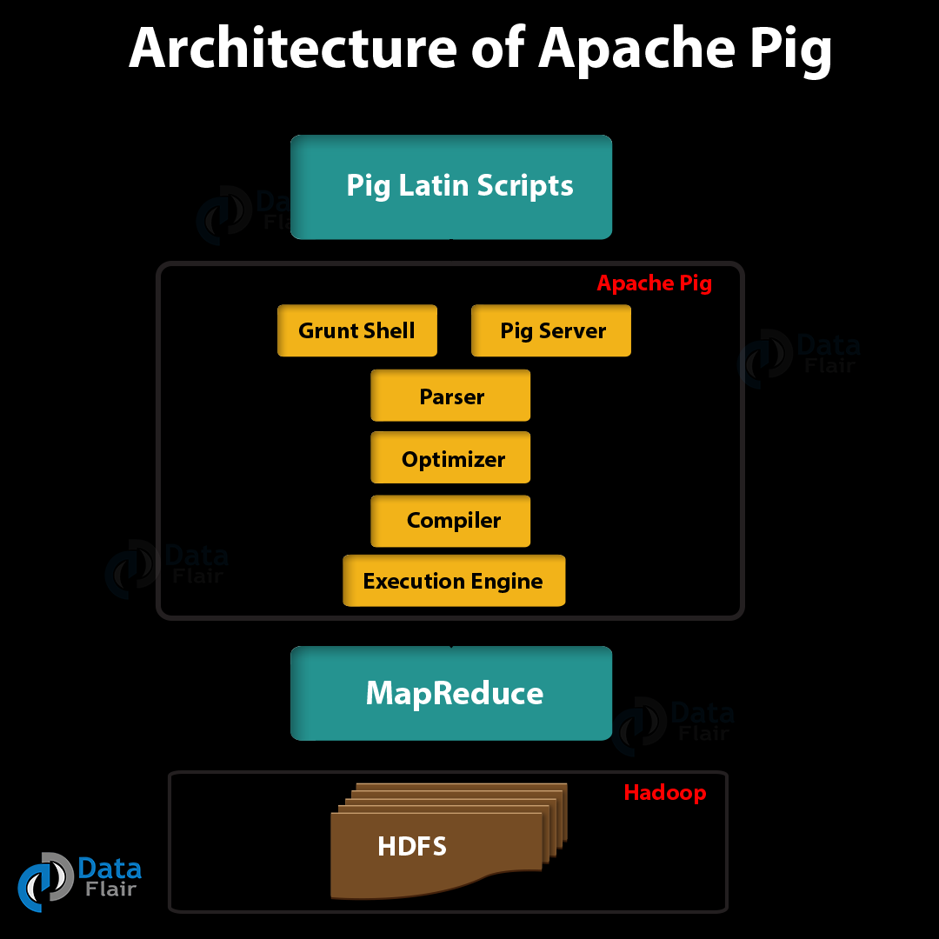
ARCHITECTURE AND TECHNOLOGY USED

Slide 5
Hadoop filesystem to store the datasets.
Pig to perform querying and analysis over the data and storing them back into Hadoop File System
A Web User Interface to attach those logs and report files using Bootstrap,php.

Slide 6
RESULTS
We will be able to get a complete new dataset which is a subset of the original dataset based on the query performed.
We will also be able to obtain a graph plotting between the location and the rate of crimes that have occurred showing us the location where the crime has occurred the most, nature of crime and a quick scan of the rate too.

Slide 7
CONCLUSION AND FUTURE WORK
With this model already implemented now for the states and Union Territories in India based on the reports from 2014-2016 that government has provided we will be able to implement them in the coming years too.

Slide 8
THANK YOU!

